Slide 1


Slide 2
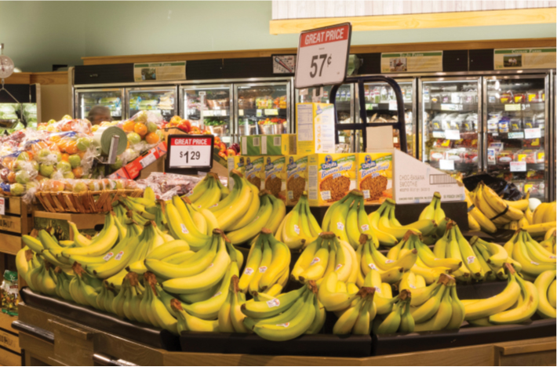
3
DEMAND AND SUPPLY

Slide 3
After studying this chapter you will be able to
Describe a competitive market and think about a price as an opportunity cost
Explain the influences on demand
Explain the influences on supply
Explain how demand and supply determine prices and quantities bought and sold
Use the demand and supply model to make predictions about changes in prices and quantities
Copyright © 2013 Pearson Canada Inc., Toronto, Ontario

Slide 4
What makes the price of coffee double in just two years and then fall by 50 percent?
Why do some prices rise, some fall, and some fluctuate?
This chapter explains how markets determine prices and why prices change.
Copyright © 2013 Pearson Canada Inc., Toronto, Ontario

Slide 5
Market and Prices
  A market is any arrangement that enables buyers and sellers to get information and do business with each other.
  A competitive market is a market that has many buyers and many sellers so no single buyer or seller can influence the price.
  The money price of a good is the amount of money needed to buy it.
  The relative price of a good—the ratio of its money price to the money price of the next best alternative good—is its opportunity cost.
Copyright © 2013 Pearson Canada Inc., Toronto, Ontario

Slide 6
Demand
  If you demand something, then you
  1. Want it,
  2. Can afford it, and
  3. Have made a definite plan to buy it.
  Wants are the unlimited desires or wishes people have for goods and services. Demand reflects a decision about which wants to satisfy.
  The quantity demanded of a good or service is the amount that consumers plan to buy during a particular time period, and at a particular price.
Copyright © 2013 Pearson Canada Inc., Toronto, Ontario

Slide 7
Demand
The Law of Demand
  The law of demand states:
  Other things remaining the same, the higher the price of a good, the smaller is the quantity demanded; and
  the lower the price of a good, the larger is the quantity demanded.
  The law of demand results from
  Substitution effect
  Income effect
Copyright © 2013 Pearson Canada Inc., Toronto, Ontario

Slide 8
Demand
  Substitution Effect
  When the price of a good or service rises relative to other prices (that is, when its opportunity cost rises), people seek substitutes for it, so the quantity demanded of the good or service decreases.
  Income Effect
  When the price of a good or service rises relative to income (that is, when the purchasing power of income falls), people cannot afford all the things they previously bought, so the quantity demanded of the good or service decreases.
Copyright © 2013 Pearson Canada Inc., Toronto, Ontario

Slide 9
Demand
Demand Curve and Demand Schedule
  The term demand refers to the entire relationship between the price of the good and quantity demanded of the good.
  A demand curve shows the relationship between the quantity demanded of a good and its price when all other influences on consumers’ planned purchases remain the same.
Copyright © 2013 Pearson Canada Inc., Toronto, Ontario

Slide 10
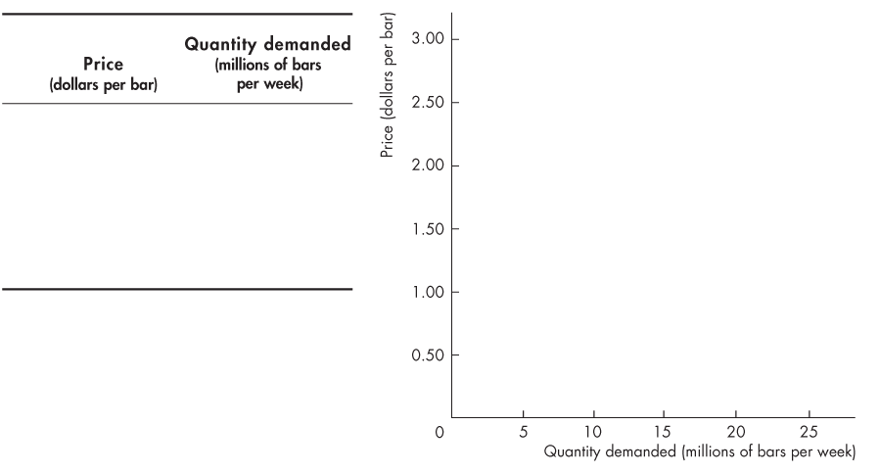
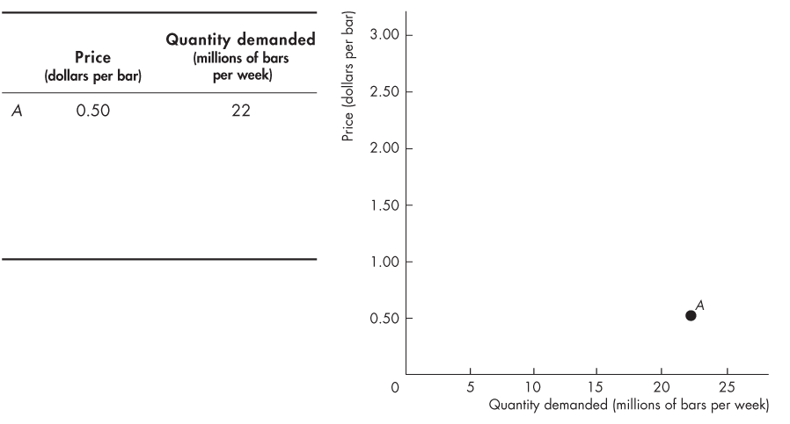
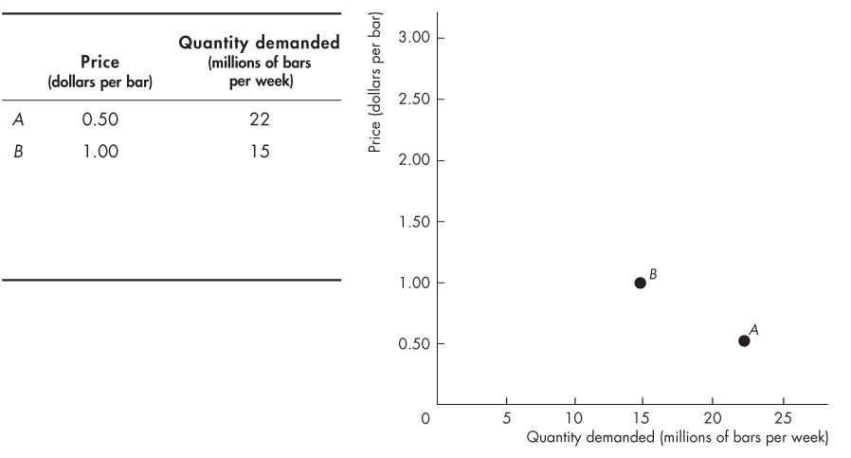
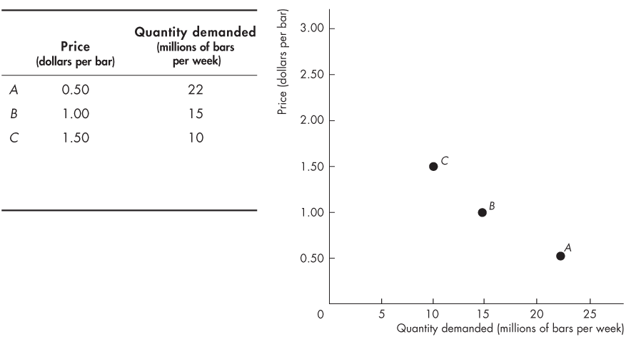
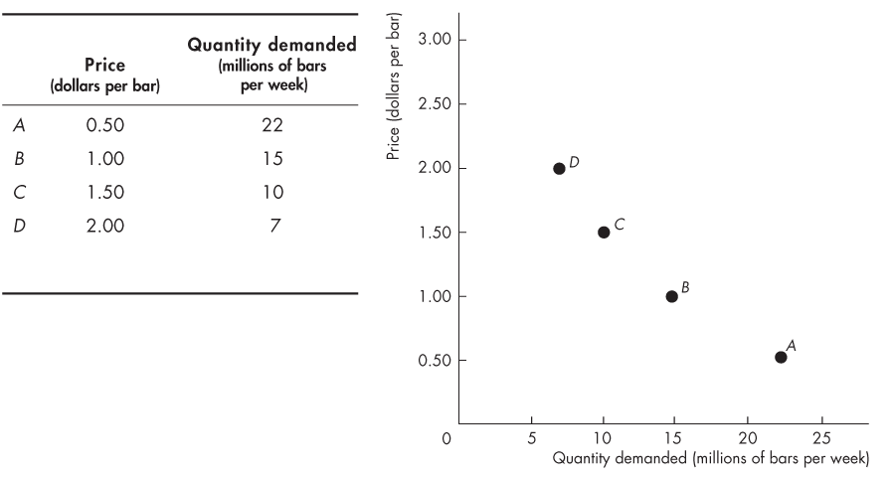
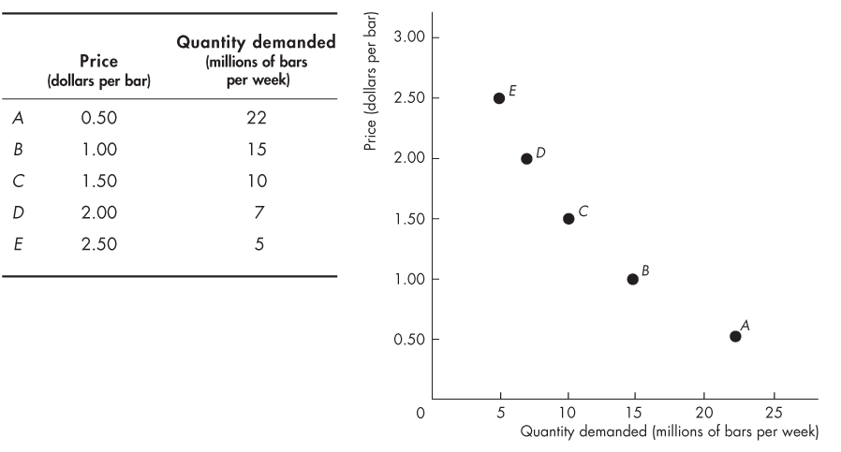
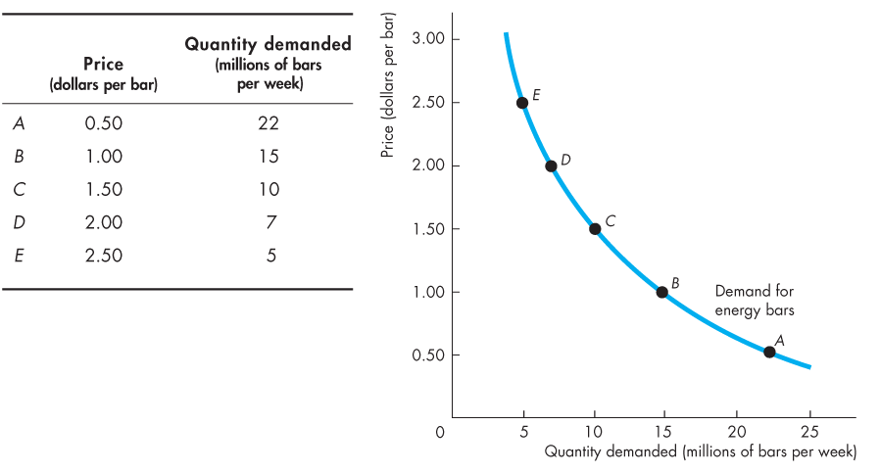
Demand
  Figure 3.1 shows a demand curve for energy bars.
Copyright © 2013 Pearson Canada Inc., Toronto, Ontario

Slide 11
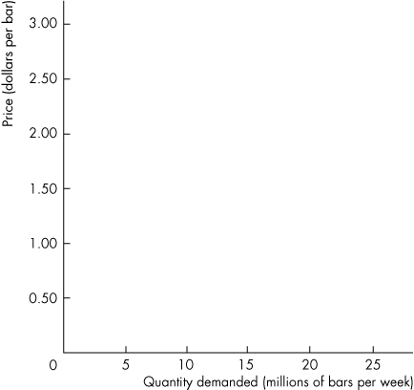
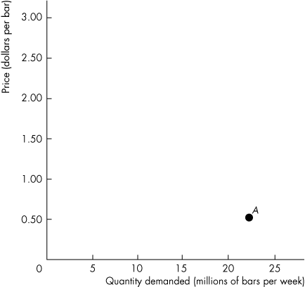
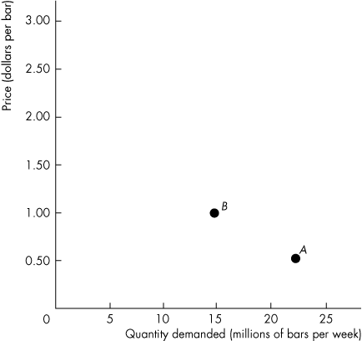
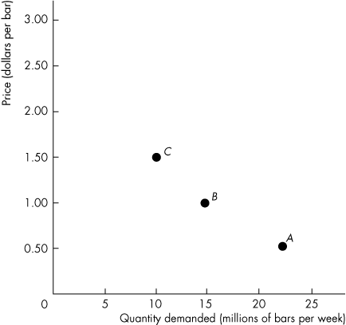
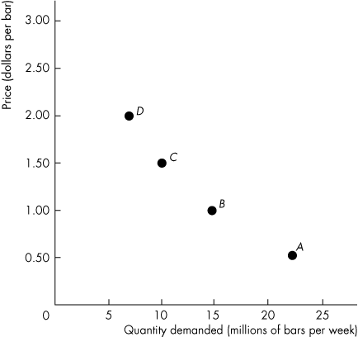
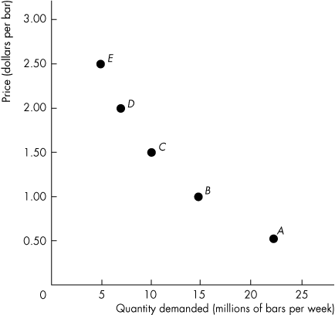
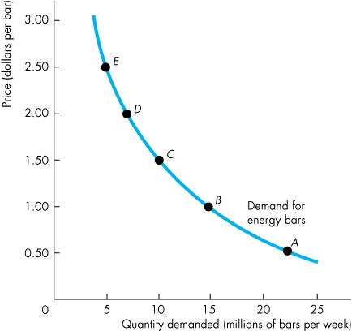
Demand
  A rise in the price, other things remaining the same, brings a decrease in the quantity demanded and a movement up along the demand curve.
  A fall in the price, other things remaining the same, brings an increase in the quantity demanded and a movement down along the demand curve.
Copyright © 2013 Pearson Canada Inc., Toronto, Ontario

Slide 12
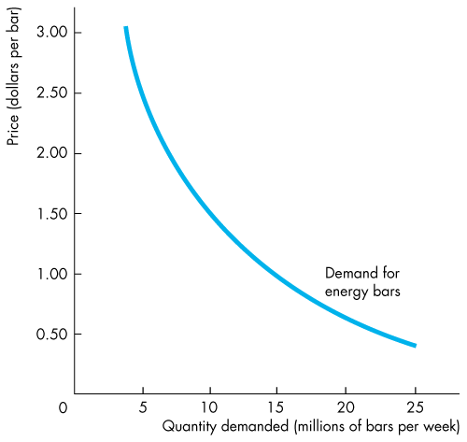
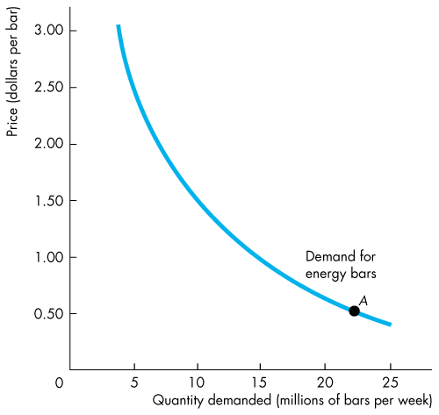
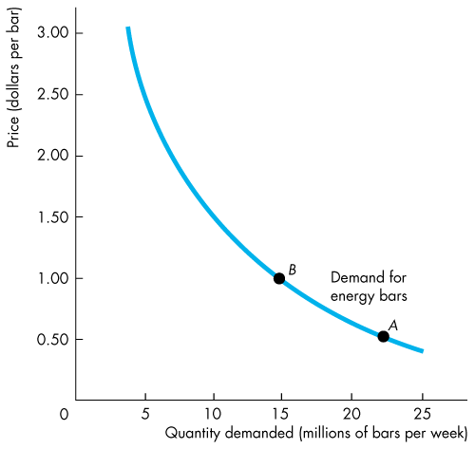
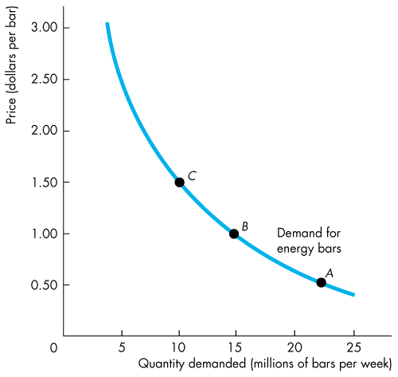

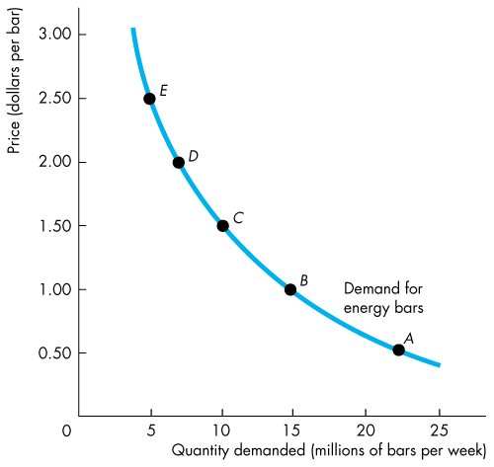
Demand
  Willingness and
  Ability to Pay
  A demand curve is also a willingness-and-ability-to-pay curve.
  The smaller the quantity available, the higher is the price that someone is willing to pay for another unit.
  Willingness to pay measures marginal benefit.
Copyright © 2013 Pearson Canada Inc., Toronto, Ontario

Slide 13
Demand
A Change in Demand
  When some influence on buying plans other than the price of the good changes, there is a change in demand for that good.
  The quantity of the good that people plan to buy changes at each and every price, so there is a new demand curve.
  When demand increases, the demand curve shifts rightward.
  When demand decreases, the demand curve shifts leftward.
Copyright © 2013 Pearson Canada Inc., Toronto, Ontario

Slide 14
Demand
  Six main factors that change demand are
  The prices of related goods
  Expected future prices
  Income
  Expected future income and credit
  Population
  Preferences
Copyright © 2013 Pearson Canada Inc., Toronto, Ontario

Slide 15
Demand
  Prices of Related Goods
  A substitute is a good that can be used in place of another good.
  A complement is a good that is used in conjunction with another good.
  When the price of substitute for an energy bar rises or when the price of a complement of an energy bar falls, the demand for energy bars increases.
Copyright © 2013 Pearson Canada Inc., Toronto, Ontario

Slide 16
Demand
  Expected Future Prices
  If the expected future price of a good rises, current demand for the good increases and the demand curve shifts rightward.
  Income
  When income increases, consumers buy more of most goods and the demand curve shifts rightward.
  A normal good is one for which demand increases as income increases.
  An inferior good is a good for which demand decreases as income increases.
Copyright © 2013 Pearson Canada Inc., Toronto, Ontario

Slide 17
Demand
  Expected Future Income and Credit
  When expected future income increases or when credit is easy to obtain, the demand might increase now.
  Population
  The larger the population, the greater is the demand for all goods.
  Preferences
  People with the same income have different demands if they have different preferences.
Copyright © 2013 Pearson Canada Inc., Toronto, Ontario

Slide 18
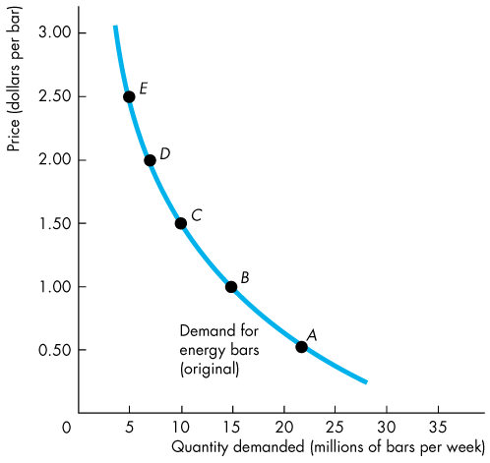
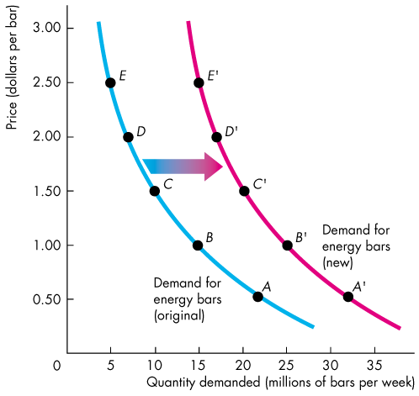
Demand
  Figure 3.2 shows an increase in demand.
  Because an energy bar is a normal good, an increase in income increases the demand for energy bars.
Copyright © 2013 Pearson Canada Inc., Toronto, Ontario

Slide 19
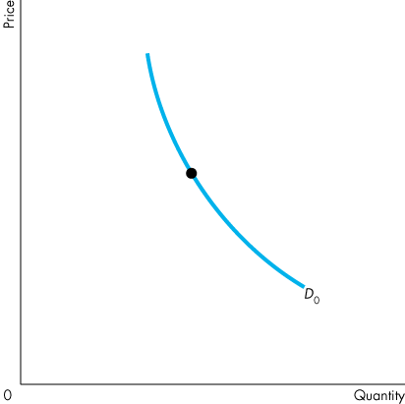
Demand
A Change in the Quantity Demanded Versus a Change in Demand
  Figure 3.3 illustrates the distinction between a change in demand and a change in the quantity demanded.
Copyright © 2013 Pearson Canada Inc., Toronto, Ontario

Slide 20
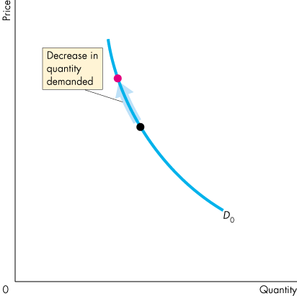
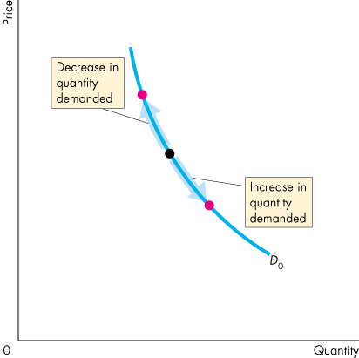
Demand
  Movement Along the Demand Curve
  When the price of the good changes and everything else remains the same, the quantity demanded changes and there is a movement along the demand curve.
Copyright © 2013 Pearson Canada Inc., Toronto, Ontario

Slide 21
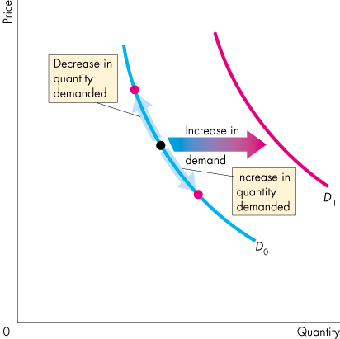
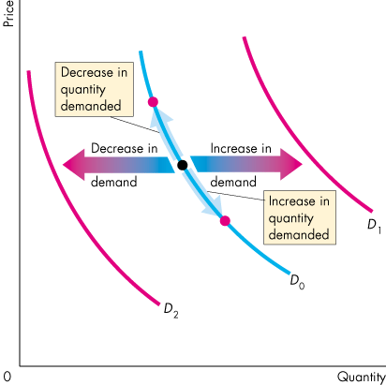
Demand
  A Shift of the Demand Curve
  If the price remains the same but one of the other influences on buyers’ plans changes, demand changes and the demand curve shifts.
Copyright © 2013 Pearson Canada Inc., Toronto, Ontario

Slide 22
Supply
  If a firm supplies a good or service, then the firm
  1. Has the resources and the technology to produce it,
  2. Can profit from producing it, and
  3. Has made a definite plan to produce and sell it.
  Resources and technology determine what it is possible to produce. Supply reflects a decision about which technologically feasible items to produce.
  The quantity supplied of a good or service is the amount that producers plan to sell during a given time period at a particular price.
Copyright © 2013 Pearson Canada Inc., Toronto, Ontario

Slide 23
Supply
The Law of Supply
  The law of supply states:
  Other things remaining the same, the higher the price of a good, the greater is the quantity supplied; and
  the lower the price of a good, the smaller is the quantity supplied.
  The law of supply results from the general tendency for the marginal cost of producing a good or service to increase as the quantity produced increases (Chapter 2, page 33).
  Producers are willing to supply a good only if they can at least cover their marginal cost of production.
Copyright © 2013 Pearson Canada Inc., Toronto, Ontario

Slide 24
Supply
Supply Curve and Supply Schedule
  The term supply refers to the entire relationship between the quantity supplied and the price of a good.
  The supply curve shows the relationship between the quantity supplied of a good and its price when all other influences on producers’ planned sales remain the same.
Copyright © 2013 Pearson Canada Inc., Toronto, Ontario

Slide 25
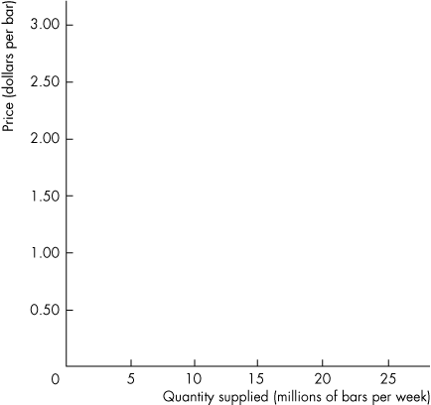
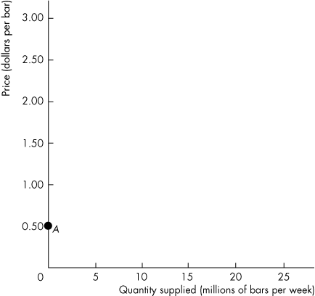
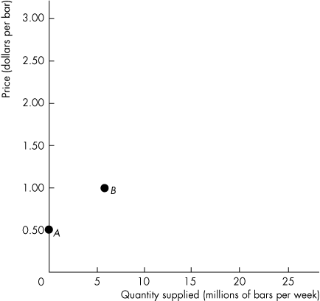
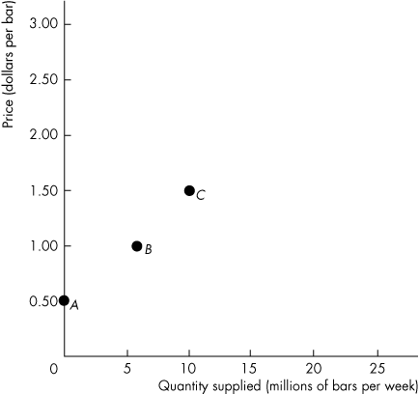
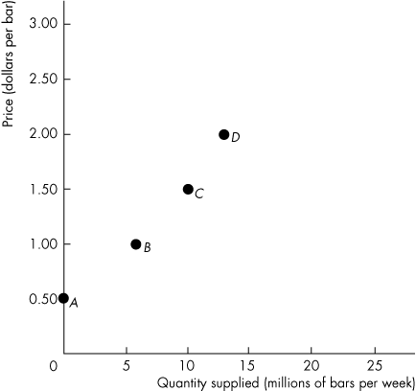
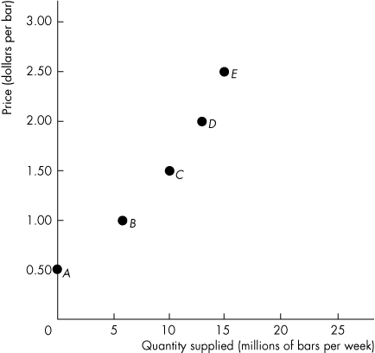
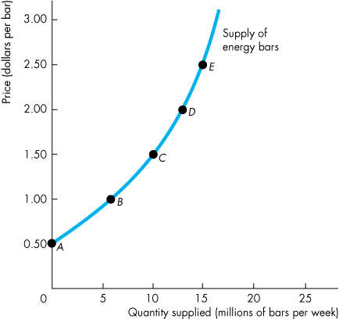
Supply
  Figure 3.4 shows a supply curve of energy bars.
  A rise in the price of an energy bar, other things remaining the same, brings an increase in the quantity supplied.
Copyright © 2013 Pearson Canada Inc., Toronto, Ontario

Slide 26
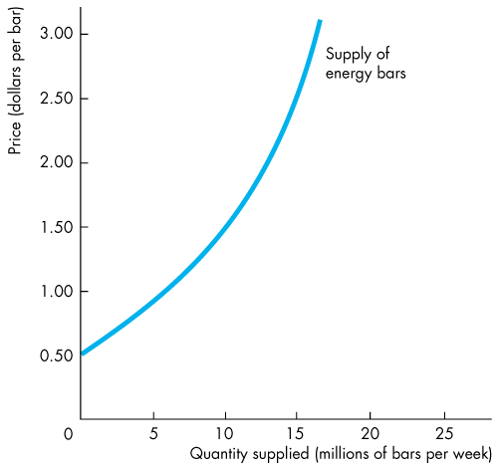

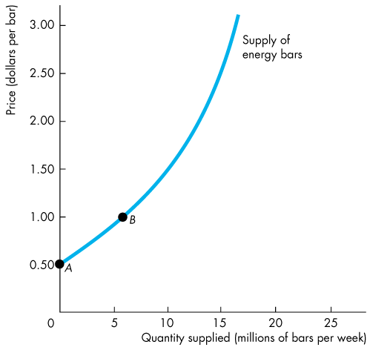
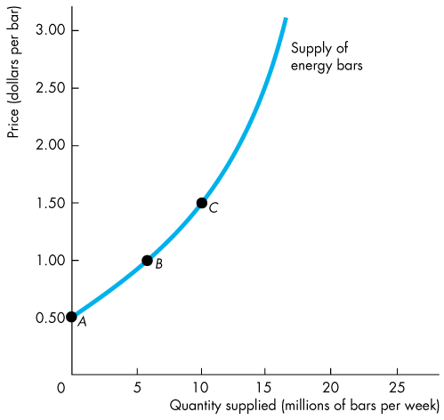
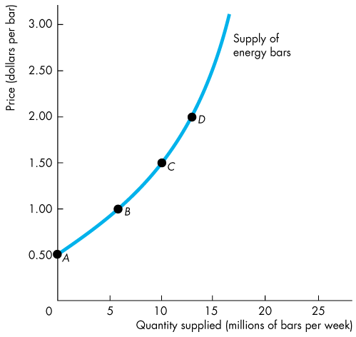
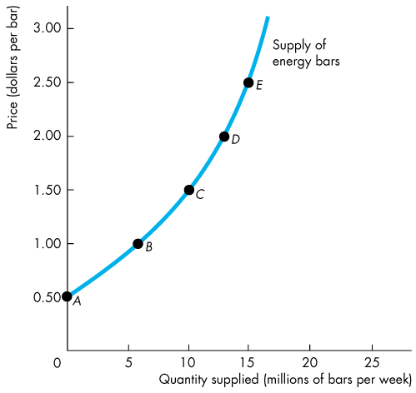
Supply
  Minimum Supply Price
  A supply curve is also a minimum-supply-price curve.
  As the quantity produced increases, marginal cost increases.
  The lowest price at which someone is willing to sell an additional unit rises.
  This lowest price is marginal cost.
Copyright © 2013 Pearson Canada Inc., Toronto, Ontario

Slide 27
Supply
A Change in Supply
  When some influence on selling plans other than the price of the good changes, there is a change in supply of that good.
  The quantity of the good that producers plan to sell changes at each and every price, so there is a new supply curve.
  When supply increases, the supply curve shifts rightward.
  When supply decreases, the supply curve shifts leftward.
Copyright © 2013 Pearson Canada Inc., Toronto, Ontario

Slide 28
Supply
The five main factors that change supply of a good are
  The prices of factors of production
  The prices of related goods produced
  Expected future prices
  The number of suppliers
  Technology
  State of nature
Copyright © 2013 Pearson Canada Inc., Toronto, Ontario

Slide 29
Supply
  Prices of Factors of Production
  If the price of a factor of production used to produce a good rises, the minimum price that a supplier is willing to accept for producing each quantity of that good rises.
  So a rise in the price of a factor of production decreases supply and shifts the supply curve leftward.
Copyright © 2013 Pearson Canada Inc., Toronto, Ontario

Slide 30
Supply
  Prices of Related Goods Produced
  A substitute in production for a good is another good that can be produced using the same resources.
  The supply of a good increases if the price of a substitute in production falls.
  Goods are complements in production if they must be produced together.
  The supply of a good increases if the price of a complement in production rises.
Copyright © 2013 Pearson Canada Inc., Toronto, Ontario

Slide 31
Supply
  Expected Future Prices
  If the expected future price of a good rises, the supply of the good today decreases and the supply curve shifts leftward.
  The Number of Suppliers
  The larger the number of suppliers of a good, the greater is the supply of the good. An increase in the number of suppliers shifts the supply curve rightward.
Copyright © 2013 Pearson Canada Inc., Toronto, Ontario

Slide 32
Supply
  Technology
  Advances in technology create new products and lower the cost of producing existing products.
  So advances in technology increase supply and shift the supply curve rightward.
  The State of Nature
  The state of nature includes all the natural forces that influence production—for example, the weather.
  A natural disaster decreases supply and shifts the supply curve leftward.
Copyright © 2013 Pearson Canada Inc., Toronto, Ontario

Slide 33
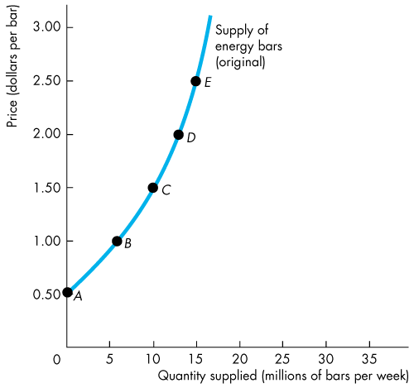
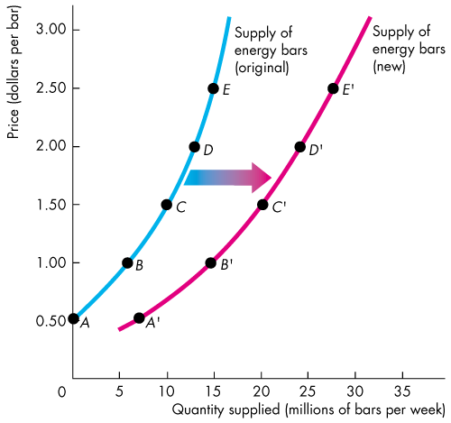
Supply
  Figure 3.5 shows an increase in supply.
  An advance in the technology for producing energy bars increases the supply of energy bars and shifts the supply curve rightward.
Copyright © 2013 Pearson Canada Inc., Toronto, Ontario

Slide 34
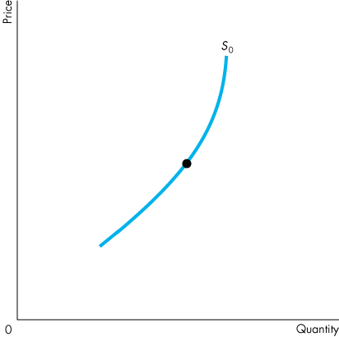
Supply
A Change in the Quantity Supplied Versus a Change in Supply
Figure 3.6 illustrates the distinction between a change in supply and a change in the quantity supplied.
Copyright © 2013 Pearson Canada Inc., Toronto, Ontario

Slide 35
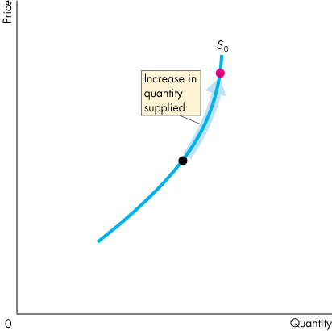
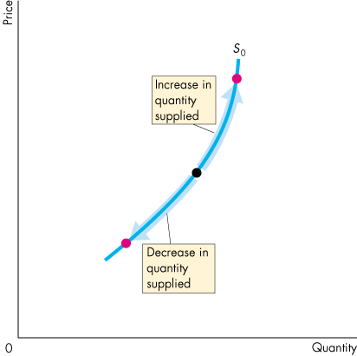
Supply
  Movement Along the Supply Curve
  When the price of the good changes and other influences on sellers’ plans remain the same, the quantity supplied changes and there is a movement along the supply curve.
Copyright © 2013 Pearson Canada Inc., Toronto, Ontario

Slide 36
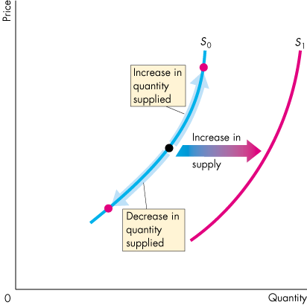
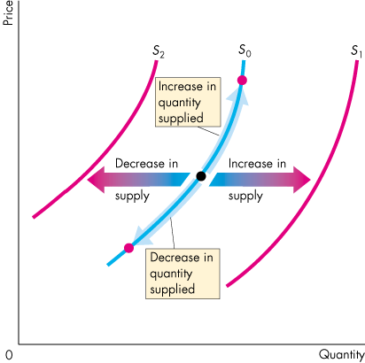
Supply
  A Shift of the Supply Curve
  If the price remains the same but some other influence on sellers’ plans changes, supply changes and the supply curve shifts.
Copyright © 2013 Pearson Canada Inc., Toronto, Ontario

Slide 37
Market Equilibrium
  Equilibrium is a situation in which opposing forces balance each other. Equilibrium in a market occurs when the price balances the plans of buyers and sellers.
  The equilibrium price is the price at which the quantity demanded equals the quantity supplied.
  The equilibrium quantity is the quantity bought and sold at the equilibrium price.
  Price regulates buying and selling plans.
  Price adjusts when plans don’t match.
Copyright © 2013 Pearson Canada Inc., Toronto, Ontario

Slide 38
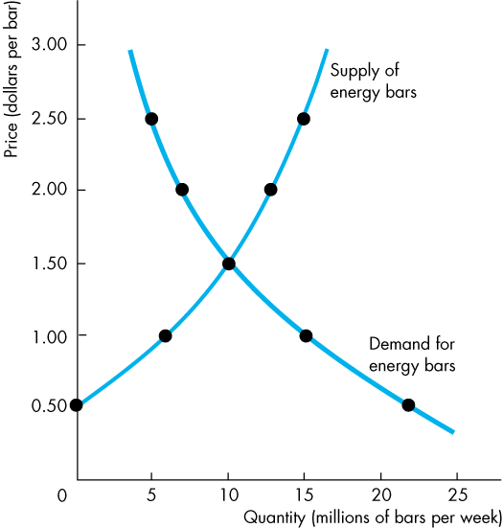
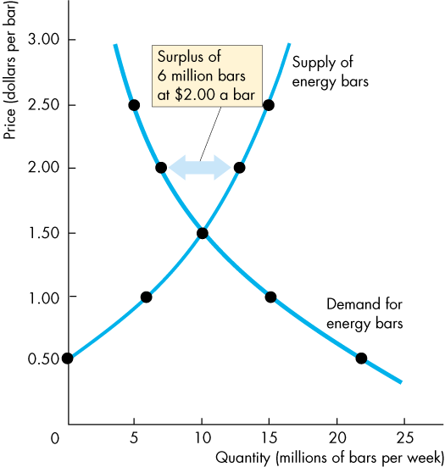
Market Equilibrium
Price as a Regulator
  Figure 3.7 illustrates the equilibrium price and equilibrium quantity.
  If the price is $2.00 a bar, the quantity supplied exceeds the quantity demanded.
  There is a surplus of
  6 million energy bars.
Copyright © 2013 Pearson Canada Inc., Toronto, Ontario

Slide 39
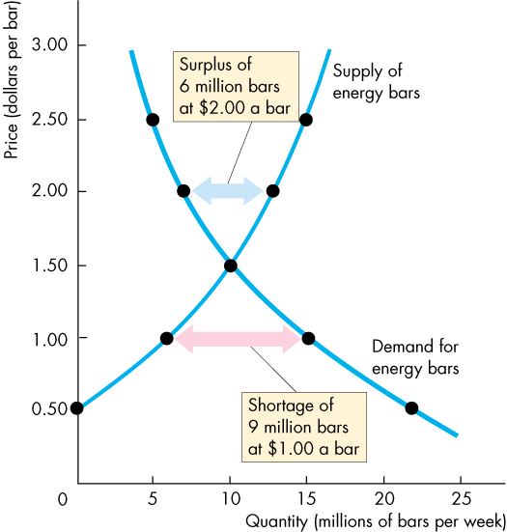
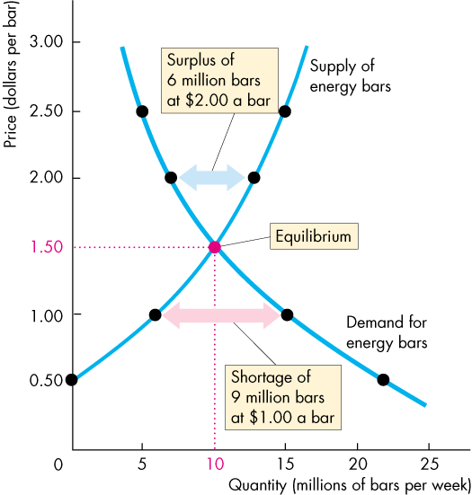
Market Equilibrium
  If the price is $1.00 a bar, the quantity demanded exceeds the quantity supplied.
  There is a shortage of
  9 million energy bars.
  If the price is $1.50 a bar, the quantity demanded equals the quantity supplied.
  There is neither a shortage nor a surplus of energy bars.
Copyright © 2013 Pearson Canada Inc., Toronto, Ontario

Slide 40
Market Equilibrium
Price Adjustments
  At any price above the equilibrium price, a surplus forces the price down.
  At any price below the equilibrium price, a shortage forces the price up.
  At the equilibrium price, buyers’ plans and sellers’ plans agree and the price doesn’t change until some event changes either demand or supply.
Copyright © 2013 Pearson Canada Inc., Toronto, Ontario

Slide 41



Predicting Changes in Price and Quantity
An Increase in Demand
  Figure 3.8 shows that when demand increases the demand curve shifts rightward.
  At the original price, there is now a shortage.
  The price rises, and the quantity supplied increases along the supply curve.
Copyright © 2013 Pearson Canada Inc., Toronto, Ontario

Slide 42



Predicting Changes in Price and Quantity
An Increase in Supply
  Figure 3.9 shows that when supply increases the supply curve shifts rightward.
  At the original price, there is now a surplus.
  The price falls, and the quantity demanded increases along the demand curve.
Copyright © 2013 Pearson Canada Inc., Toronto, Ontario

Slide 43



Predicting Changes in Price and Quantity
All Possible Changes in Demand and Supply
  A change demand or supply or both demand and supply changes the equilibrium price and the equilibrium quantity.
Copyright © 2013 Pearson Canada Inc., Toronto, Ontario

Slide 44





Predicting Changes in Price and Quantity
Change in Demand with No Change in Supply
  When demand increases,
  there is a movement up along the supply curve.
  The equilibrium price rises and the equilibrium quantity increases.
Copyright © 2013 Pearson Canada Inc., Toronto, Ontario

Slide 45





Predicting Changes in Price and Quantity
  When demand decreases, the equilibrium price falls and the equilibrium quantity decreases.
Copyright © 2013 Pearson Canada Inc., Toronto, Ontario

Slide 46





Predicting Changes in Price and Quantity
Change in Supply with
No Change in Demand
  When supply increases,
  there is a movement down along the demand curve.
  The equilibrium price falls and the equilibrium quantity increases.
Copyright © 2013 Pearson Canada Inc., Toronto, Ontario

Slide 47





Predicting Changes in Price and Quantity
  When supply decreases,
  the equilibrium price rises and the equilibrium quantity decreases.
Copyright © 2013 Pearson Canada Inc., Toronto, Ontario

Slide 48




Predicting Changes in Price and Quantity
Increase in Both Demand and Supply
  An increase in demand and an increase in supply increase the equilibrium quantity.
  The change in equilibrium price is uncertain because the increase in demand raises the equilibrium price and the increase in supply lowers it.
Copyright © 2013 Pearson Canada Inc., Toronto, Ontario

Slide 49




Predicting Changes in Price and Quantity
Decrease in Both Demand and Supply
  A decrease in both demand and supply decreases the equilibrium quantity.
  The change in equilibrium price is uncertain because the decrease in demand lowers the equilibrium price and the decrease in supply raises it.
Copyright © 2013 Pearson Canada Inc., Toronto, Ontario

Slide 50




Predicting Changes in Price and Quantity
Decrease in Demand and Increase in Supply
  A decrease in demand and an increase in supply lowers the equilibrium price.
  The change in equilibrium quantity is uncertain because the decrease in demand decreases the equilibrium quantity and the increase in supply increases it.
Copyright © 2013 Pearson Canada Inc., Toronto, Ontario

Slide 51




Predicting Changes in Price and Quantity
Increase in Demand and Decrease in Supply
  An increase in demand and a decrease in supply raises the equilibrium price.
  The change in equilibrium quantity is uncertain because the increase in demand increases the equilibrium quantity and the decrease in supply decreases it.
Copyright © 2013 Pearson Canada Inc., Toronto, Ontario

